Slide 1

35th International Physics Olympiad
Pohang, Korea
15 ~ 23 July 2004
Theoretical Question 1
Theoretical Competition
Saturday, 17 July 2004

Slide 2
Theoretical Question 1:
“Ping-Pong Resistor”
Objective: To find current through the capacitor plates
R
V
d

Slide 3

Theoretical Question 1:
“Ping-Pong Resistor”
Problem design:
R
V
d
side view
+V
Q=CV
d
r
F=qE - mg
t
q
mg

Slide 4
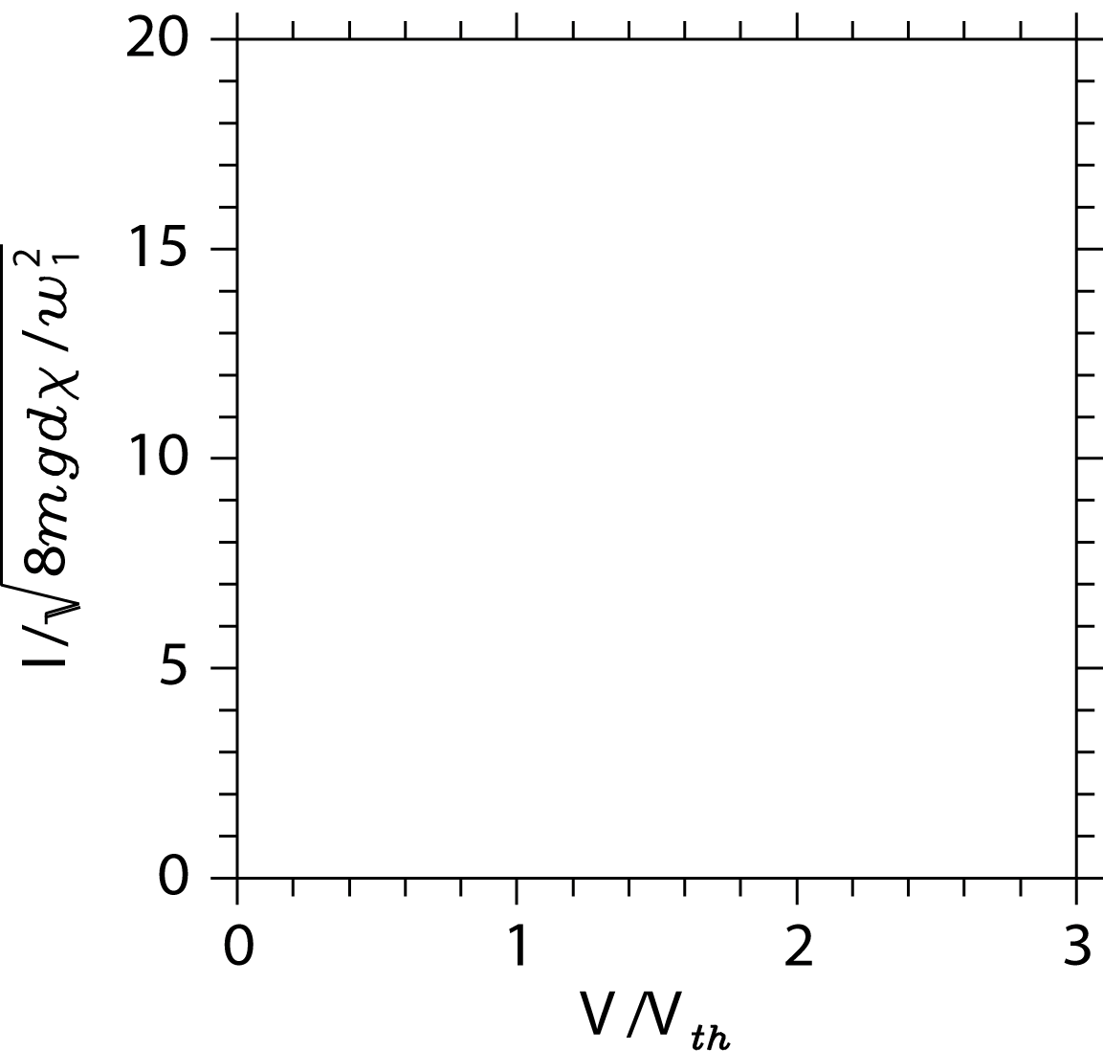
I-V Curves

Slide 5
Theoretical Question 1:
“Ping-Pong Resistor”
Physical concepts required:
  Electrostatics
    Electric Field, Potential
    Gauss’ Law
    Current
  Mechanics
    Energy Conservation
    Collisions
    Kinematics
R
V
d

